Slide 1
Introduction to Database Systems
Database Systems
Department of Computer Science, CBNU
Prof. Nasridinov Aziz (aziz@chungbuk.ac.kr)

Slide 2
Table of Contents
What is Database?
Data Model
Database Management System (DBMS)
Database Systems
Database Languages
Recent Techs in Database Systems
Summary and Discussions

Slide 3
1. What is Database?
What is data?
  Since birth, we are surrounded with data
  Since people first started writing, they have recorded their observations
  Since computers were invented in the 1950s, data is known as information that is stored or shared electronically
  In simple words, data means facts, numbers, charts, or information that a computer stores or uses

Slide 4
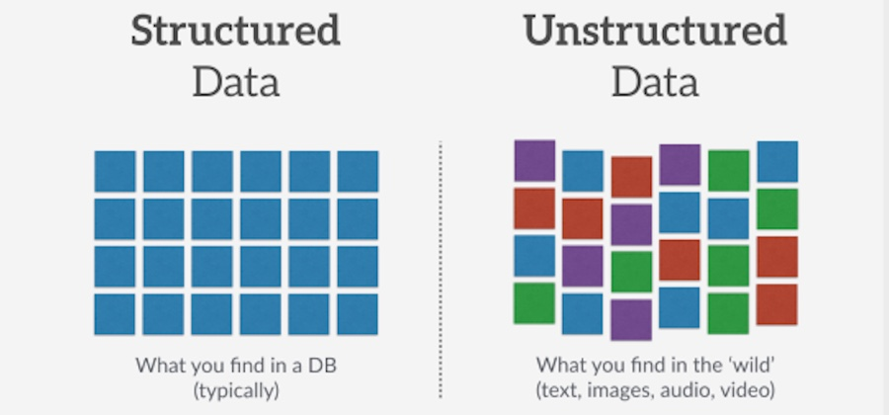
1. What is Database?
What types of data exist?
  Structured vs. Unstructured data
In this lecture, we will focus on Structured Data

Slide 5
1. What is Database?
Database
  An organized collection of data
Examples of Database Applications
  Universities: student management, registration, grades
  Airlines: reservations, schedules
  Hospitals: patient data
  Retail: customers, products, purchases, order track
  Banking and finance
    customer information, accounts, loans, and card usage

Slide 6
2. Data Model
What is Data Model?
  Used to show how data is stored, connected, accessed and updated in the database
Types of data models
  Hierarchical Model
  Network Model
  Hybrid Model (Combination of Hierarchical and Network Model)
  Relational Model <- This lecture will focus on Relation Model
  Object-Oriented Model
  Object-Relational Model

Slide 7
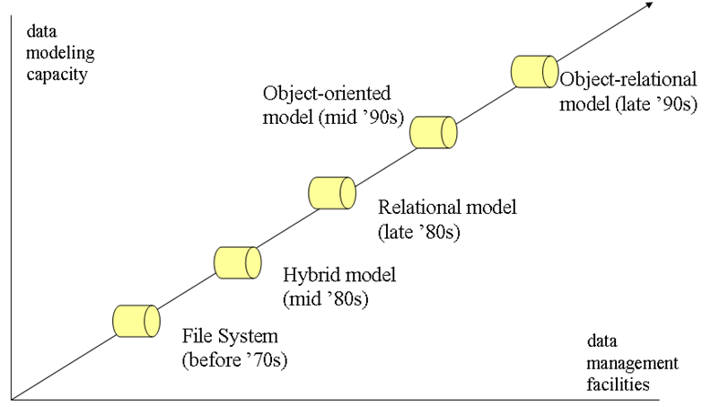
2. Data Model
History of Data Models

Slide 8
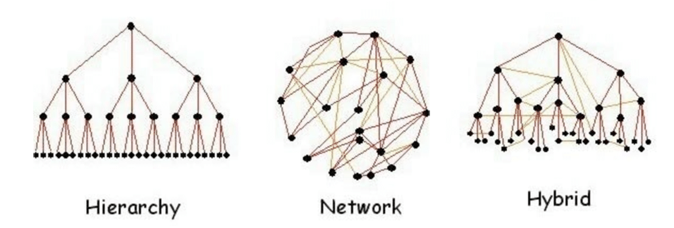
2. Data Model
Hybrid Models
  Hierarchical Data Model: Organizes the data in the tree-like structure
  Network Data Model: Organizes the data in directed graph structure
  Hybrid Data Model: Combination of Hierarchical and Network Data Models

Slide 9
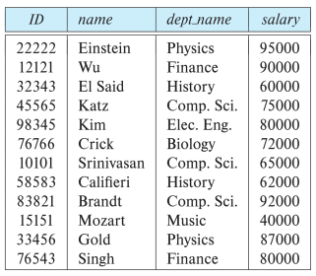
2. Data Model
Relational Model
  Represents the database as a collection of relations
    Relation = table
The instructor relation

Slide 10
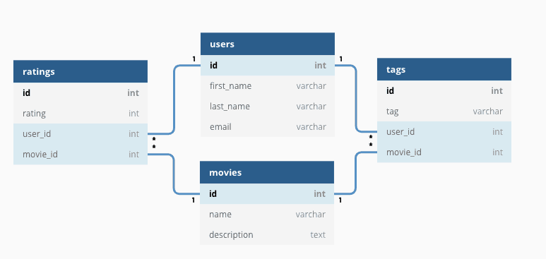
2. Data Model
What is relational database?
  Allows related data to be stored across multiple tables, and linked by establishing a relationship between the tables

Slide 11
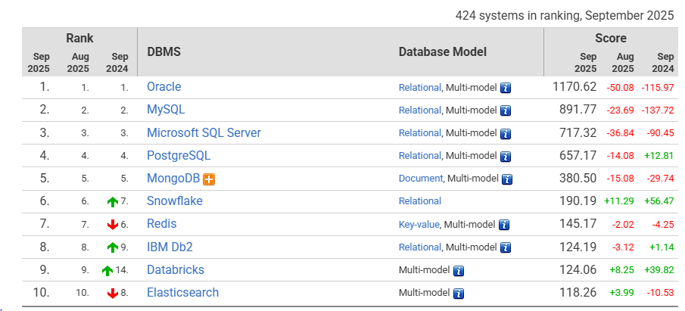
3. Database Management System (DBMS)
DBMS
  A software designed to store, retrieve, define, and manage data in a database
Ranking of various well-known DBMS

Slide 12
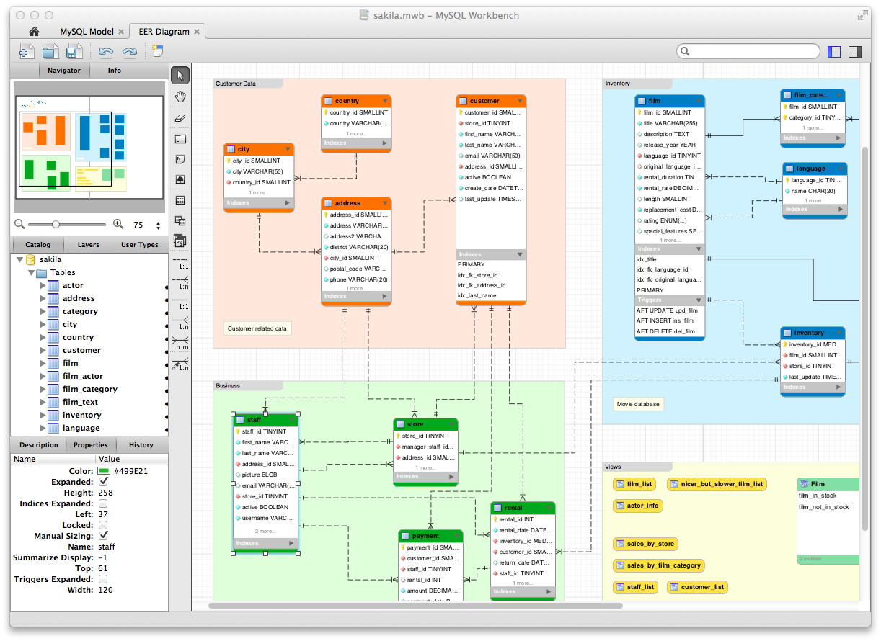
3. Database Management System (DBMS)
GUI Interface of MySQL

Slide 13
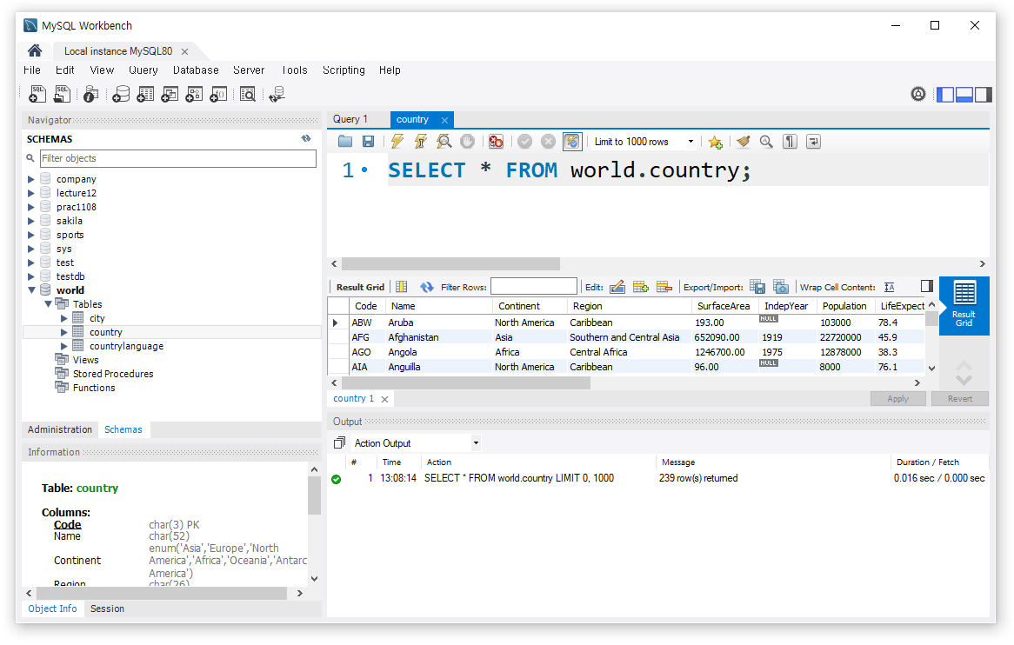
3. Database Management System (DBMS)
Query
  A query in a database is a request for information from a DBMS
    Retrieve data or change (add or remove) information in a database
1. Query
2. Result of query

Slide 14
3. Database Management System (DBMS)
Purpose of DBMS
  Allows to create a new database
  Allows you to specify the structure of the database
  Allows users to query and modify data efficiently
  Protects data from system failure or unauthorized users
  Controls access to the database by multiple users at the same time

Slide 15
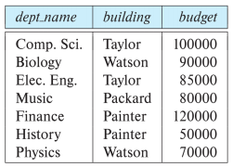
4. Database Systems
Database Schema
  The overall logical structure of the database, also called metadata
    Ex: department(dept_name, building, budget)
Database Instance
  The actual content of the database at a particular point in time
The department table

Slide 16
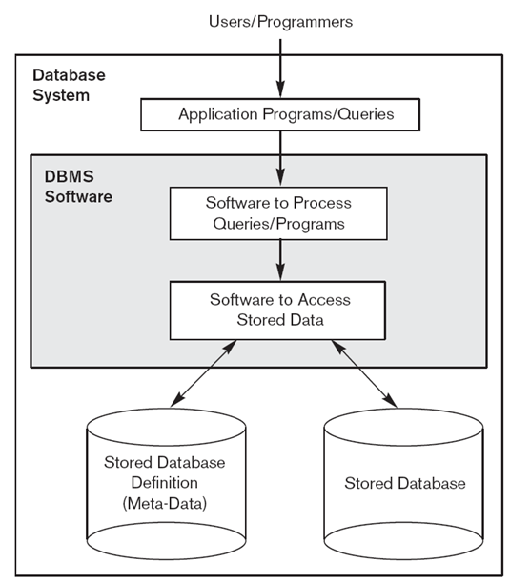
4. Database Systems
What is Database Systems?
  Users, application programs, DBMS and stored database are referred to as a database system
Database schema
is stored here
Database instances
are stored here

Slide 17
4. Database Systems
Characteristics of Database Systems
  Allows multiple users to access and manipulate data in the database simultaneously
  Eliminates data redundancy by storing data in a centralized database
  Enforces integrity constraints to ensure data consistency and accuracy
  Enables data independence by separation of data and application programs
  Provides security features to protect the data from unauthorized access
  Supports backup and recovery features to prevent data loss

Slide 18
4. Database Systems
Database users
  Naïve Users
    Users with no knowledge in DBMS, but frequently use the database application in their daily life
  Database Designers
    Users who design the structure of database
      tables, indexes, views, triggers, stored procedures and constraints
  Application Programmers
    Back-end developers who design, debug, test, and maintain set of programs to interact with database

Slide 19
4. Database Systems
Database users
  Sophisticated users
    Interact with database without writing programs. Typically, using database query language like SQL
  Database Administrators (DBA)
    Routine maintenance
    Granting of authorization for data access
    Backup and recovery
    Database tuning and performance monitoring

Slide 20
5. Database Languages
Structural Query Language (SQL)
  Define queries to access and manipulate the data from database
  A procedural language, not a programming language
  A standard language for RDBMS
    Oracle, MySQL, Microsoft SQL and others
  SQL statements are divided into four major categories
    Data Definition Language (DDL)
    Data Manipulation Language (DML)
    Data Control Language (DCL)
    Transaction Control Language (TCL)

Slide 21
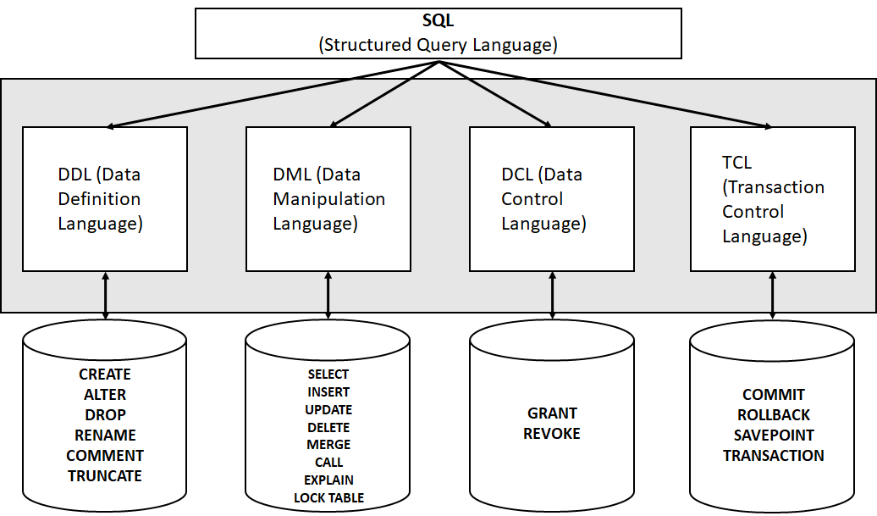
5. Database Languages
Structural Query Language (SQL)

Slide 22
5. Database Languages
Data Definition Language (DDL)
  A language for defining the database schema
    Used to create and modify the structure of your tables and database objects
  Example (Creating a new table)
    CREATE TABLE department(
    dept_name varchar(20),
    building varchar(20),
    budget numeric(8,2))
  Other DDL statements include ALTER, DROP, RENAME, COMMENT and TRUNCATE

Slide 23
5. Database Languages
Data Manipulation Language (DML)
  A language for searching, modifying, inserting and deleting the desired data in the database
    DML also known as query language
  Example (Selecting rows)
    SELECT name
    FROM instructor
    WHERE dept_name=‘Comp.Sci.’
  Other DML statements include INSERT, UPDATE, DELETE and others

Slide 24
5. Database Languages
Data Control Language (DCL)
  Mainly deal with the rights, permissions, and other controls of the database system
  Example (Granting privilege)
    GRANT SELECT ON department
    TO 'aziz'@'localhost;
  Other DCL statements include REVOKE

Slide 25
5. Database Languages
Transaction Control Language (TCL)
  Used to manage data security, data integrity, data recovery and data concurrency
  TCL Commands
    COMMIT
    ROLLBACK
    SAVEPOINT
    SET TRANSACTION

Slide 26
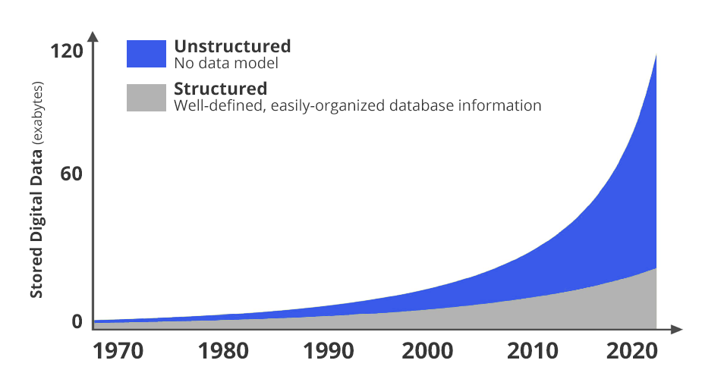
6. Recent Techs in Database Systems
According to Seagate, the volume of data generated worldwide will increase from 33 in 2018 to about 175 zettabytes in 2025
Data Growth

Slide 27
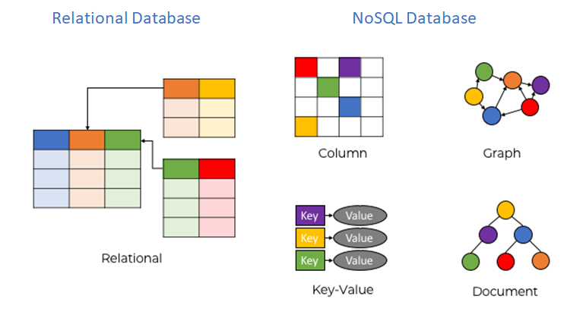
6. Recent Techs in Database Systems
NoSQL
  Non-relational databases

Slide 28
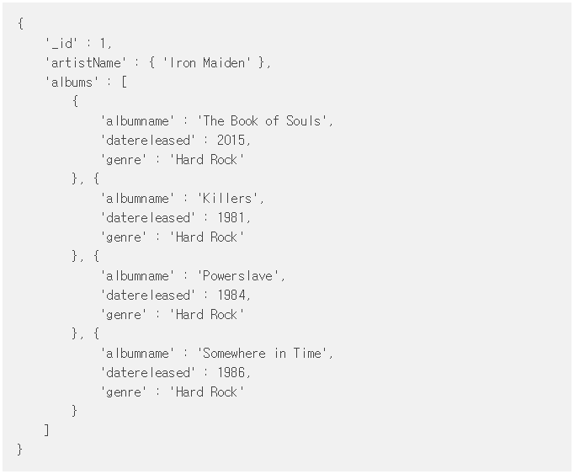
6. Recent Techs in Database Systems
NoSQL
  Example of data in MongoDB (Document database)
<Data stored in JSON format>

Slide 29
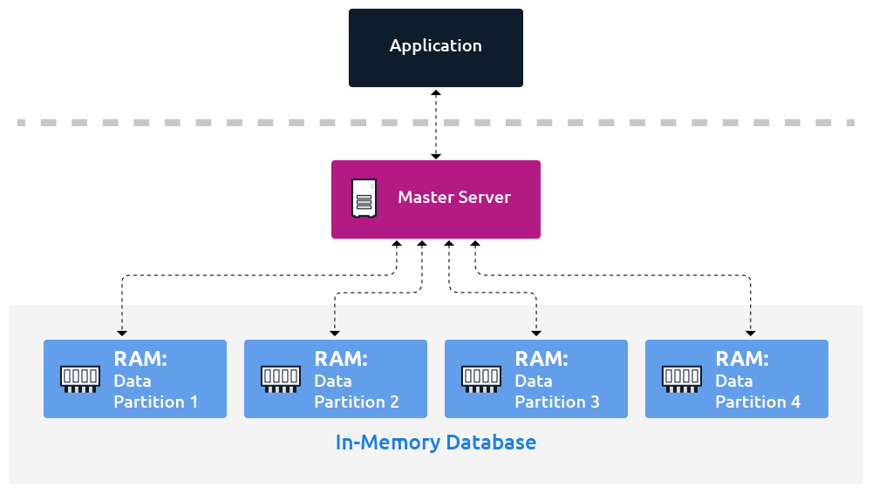
6. Recent Techs in Database Systems
In-Memory Databases
  Data is stored directly in the computer’s main memory (RAM)
    Enable minimal response times by eliminating the need to access hard disks

Slide 30
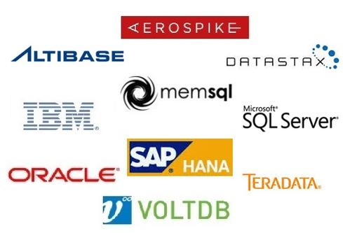
6. Recent Techs in Database Systems
In-Memory Databases
  Popular DBMS

Slide 31
7. Summary and Discussions
Database
  An organized collection of data
Database Management Systems (DBMS)
  A software designed to store, retrieve, define, and manage data in a database
Meta-Data (System Catalog or Data Dictionary)
  Describes the structure of the database
Database Systems
  Users, application programs, DBMS and stored database are referred to as a database system

Slide 32
7. Summary and Discussions
Data Models are used to show how data is stored, connected, accessed and updated in the DBMS
Types of data models
  Hierarchical Model
  Network Model
  Relational Model
  Object-Oriented Model
  Object-Relational Model
Relational Model
  Represents the database as a collection of relations

Slide 33
7. Summary and Discussions
Structural Query Language (SQL)
  Define queries to access and manipulate the data from database
SQL statements are divided into four major categories
  Data Definition Language (DDL)
  Data Manipulation Language (DML)
  Data Control Language (DCL)
  Transaction Control Language (TCL)
Recent Techs in DB
  NoSQL Databases
  In-Memory Databases

Slide 34
Quiz
What is Big Data? Where do you often encounter the Big Data?
What do you think where it is NOT recommended to use the database?
Given the following relation, indicate database schema and instances.
ID | Name | Major | Grade | Email
1000 | Tim | Computer | Male | tim@gmail.com
1001 | Sonya | Art | Female | sonya@naver.com
1002 | Brain | Social | Male | brain@yahoo.com
1003 | Natasha | Math | Female | natasha@outlook.com
The student relation

